Slide 1
MODERN OPERATING SYSTEMS
Chapter 1
Introduction
Tanenbaum, Modern Operating Systems 3 e, (c) 2008 Prentice-Hall, Inc. All rights reserved. 0-13-6006639

Slide 2
What Is An Operating System?
Lots of hardware !!
One or more processors
Main memory
Disks
Printers
Various input/output devices
Managing all these components requires a layer of software – the operating system
Tanenbaum, Modern Operating Systems 3 e, (c) 2008 Prentice-Hall, Inc. All rights reserved. 0-13-6006639

Slide 3
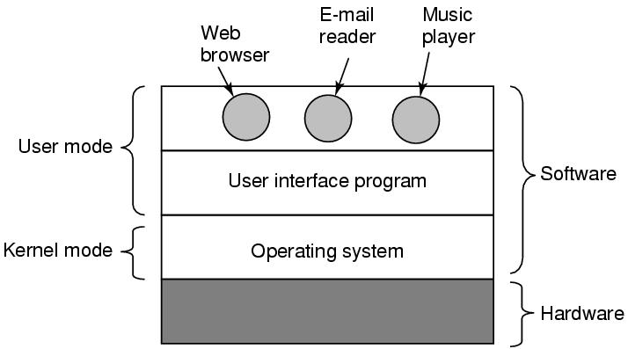
Where is the software?
Where the operating system fits in.
Tanenbaum, Modern Operating Systems 3 e, (c) 2008 Prentice-Hall, Inc. All rights reserved. 0-13-6006639

Slide 4
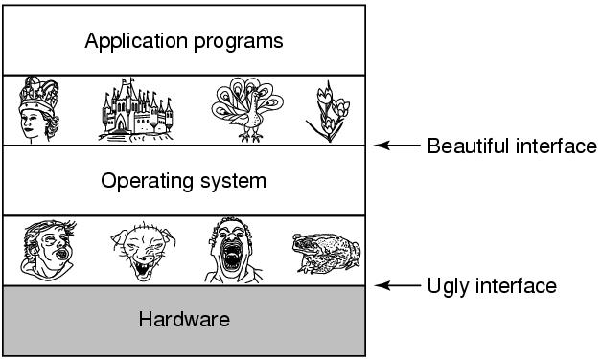
The Operating System as an Extended Machine
Tanenbaum, Modern Operating Systems 3 e, (c) 2008 Prentice-Hall, Inc. All rights reserved. 0-13-6006639

Slide 5
The Operating System as a Resource Manager
Allow multiple programs to run at the same time
Manage and protect memory, I/O devices, and other resources
Multiplexes (shares) resources in two different ways:
  In time
  In space
Tanenbaum, Modern Operating Systems 3 e, (c) 2008 Prentice-Hall, Inc. All rights reserved. 0-13-6006639

Slide 6
Operating System Concepts
Process
Program in execution
Lives in address space
Process table
  Keeps info about process
  Used to re-start process
Tanenbaum, Modern Operating Systems 3 e, (c) 2008 Prentice-Hall, Inc. All rights reserved. 0-13-6006639

Slide 7

A Process Tree
Ex: MS-Word creating child process
Process creates child processes
Tree structure
Tanenbaum, Modern Operating Systems 3 e, (c) 2008 Prentice-Hall, Inc. All rights reserved. 0-13-6006639

Slide 8
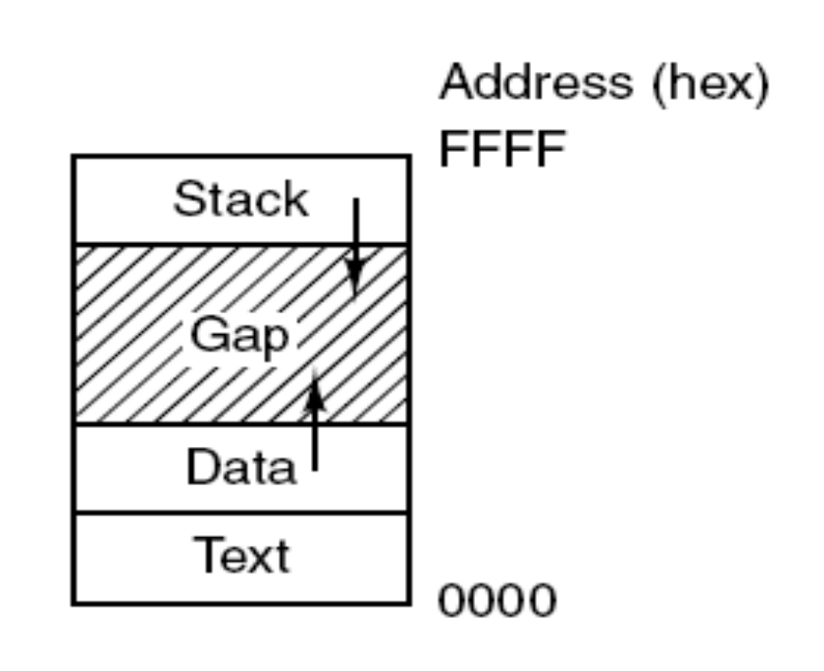
Memory Layout
Processes have three segments:
text, data, and stack.
Tanenbaum, Modern Operating Systems 3 e, (c) 2008 Prentice-Hall, Inc. All rights reserved. 0-13-6006639

Slide 9
Process
Can communicate with one another
Have UID’s and group ID’s (GID)
Can communicate with one another (IPC)
Tanenbaum, Modern Operating Systems 3 e, (c) 2008 Prentice-Hall, Inc. All rights reserved. 0-13-6006639

Slide 10
System Calls
Interface between user programs and OS
Varies from OS to OS
System call issued by user program
Call uses a library call of the same name
Library routine puts machine into kernel modes (by issuing a special instruction)
Finds actual routine for system call in a table
Does the work involved in the call
Returns to user program
Tanenbaum, Modern Operating Systems 3 e, (c) 2008 Prentice-Hall, Inc. All rights reserved. 0-13-6006639

Slide 11
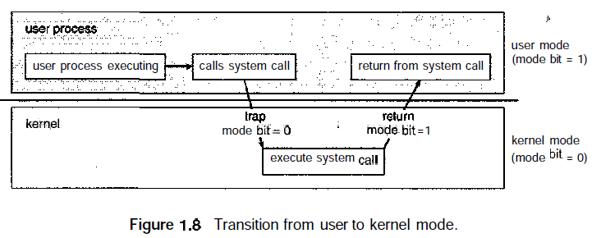
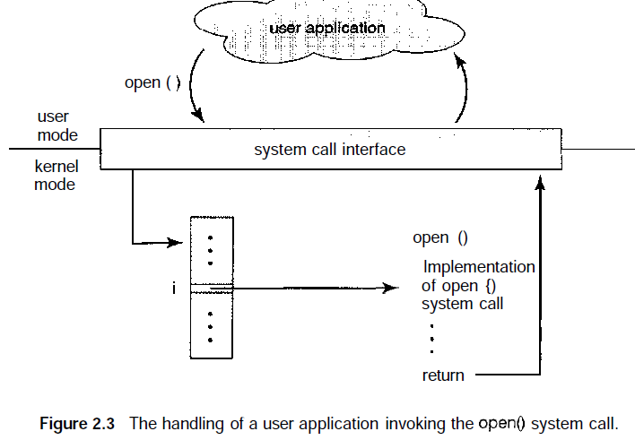
System Calls
GALVIN – Chapter 1
Page: 19 and 46
Tanenbaum, Modern Operating Systems 3 e, (c) 2008 Prentice-Hall, Inc. All rights reserved. 0-13-6006639

Slide 12
Types of System Calls
Five major categories
Process control
  end, abort
  load, execute
  create process, terminate process
  get process attributes, set process attributes
  wait for time
  wait event, signal event
  allocate and free memory
File manipulation
  create file, delete file
  open, close
  read, write, reposition
  get file attributes, set file attributes
GALVIN – Chapter 2
Page: 47-54
Tanenbaum, Modern Operating Systems 3 e, (c) 2008 Prentice-Hall, Inc. All rights reserved. 0-13-6006639

Slide 13
Types of System Calls
Device manipulation
  request device, release device
  read, write, reposition
  get device attributes, set device attributes
  logically attach or detach devices
Information maintenance
  get time or date, set time or date
  get system data, set system data
  get process, file, or device attributes
  set process, file, or device attributes
Communications
  create, delete communication connection
  send, receive messages
  transfer status information
  attach or detach remote devices
GALVIN – Chapter 2
Page: 47-54
Tanenbaum, Modern Operating Systems 3 e, (c) 2008 Prentice-Hall, Inc. All rights reserved. 0-13-6006639

Slide 14
Unix Read System Call
Count=read(fd, buffer, nbytes)
  fd is a file descriptor. When a file is opened, permissions are checked. If access is allowed, a number (fd) is returned. Then file can be read/written
  nbytes is number of bytes in file
  buffer is where read deposits the bytes
Tanenbaum, Modern Operating Systems 3 e, (c) 2008 Prentice-Hall, Inc. All rights reserved. 0-13-6006639

Slide 15

System Calls
read(fd, buffer, nbytes).
Tanenbaum, Modern Operating Systems 3 e, (c) 2008 Prentice-Hall, Inc. All rights reserved. 0-13-6006639

Slide 16
Fork
Pid=fork( )
  Duplicates parent process completely Everything duplicated -data,registers,fd’s
  Fork returns a value (pid)
    Zero in child
    Child’s PID in parent
    Used to differentiate child from parent
Tanenbaum, Modern Operating Systems 3 e, (c) 2008 Prentice-Hall, Inc. All rights reserved. 0-13-6006639

Slide 17
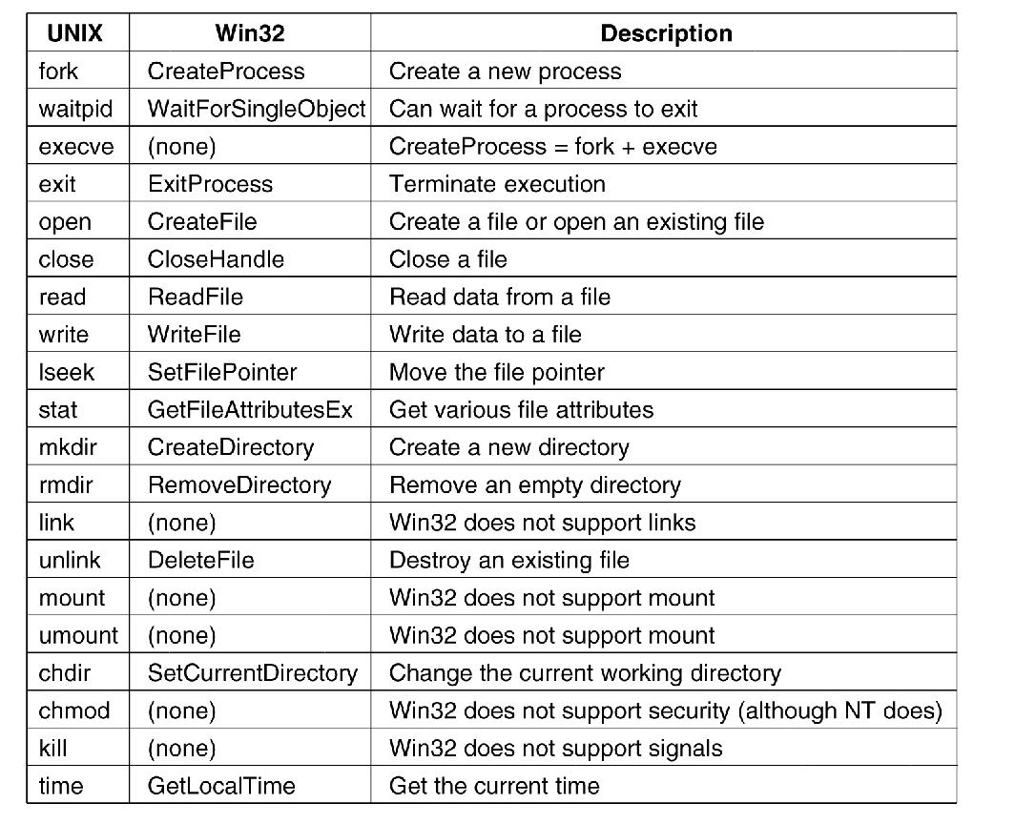
Windows Win32 API
The Win32 API calls that roughly correspond
to the UNIX calls
Tanenbaum, Modern Operating Systems 3 e, (c) 2008 Prentice-Hall, Inc. All rights reserved. 0-13-6006639

Slide 18
Operating Systems Architecture
Monolithic systems
A main program that invokes the requested service procedure.
A set of service procedures that carry out the system calls.
A set of utility procedures that help the service procedures.
All the basic system services like process and memory management, interrupt handling etc. are packaged into a single module in kernel space.
Tanenbaum, Modern Operating Systems 3 e, (c) 2008 Prentice-Hall, Inc. All rights reserved. 0-13-6006639

Slide 19
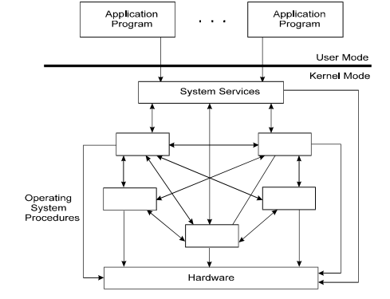
Monolithic systems

Slide 20
Monolithic systems
Drawbacks
1) Size of kernel is huge.
2) Poor maintainability, which means bug fixing or addition of new features resulted in recompilation of the whole kernel which could consume hours
3) A crash in any of these procedures will take down the entire operating system
Modern day approach:
> The kernel consists of different modules which can be dynamically loaded and un-loaded.
> This modular approach allows easy extension of OS's capabilities.

Slide 21
Monolithic systems
Maintainability of kernel became very easy
  Only the concerned module needs to be loaded and unloaded every time there is a change or bug fix in a particular module.
> No need to bring down and recompile the whole kernel for a smallest bit of change.
Stripping of kernel for various platforms became very easy
  Can easily unload the module that we do not want.
MS-Dos, Windows 9x, Linux, Android

Slide 22
Microkernels
Small number of processes are allowed in the kernel
  Managing memory protection
  Process scheduling
  Inter Process communication (IPC)
Device driver management, protocol stack, file system etc. may run in the user space ( They are called servers and loaded during the time the OS boots-up)
  Microkernel servers are daemon programs
  The Kernel grants some of them privileges to interact with parts of physical memory that are otherwise off limits to most programs.
  This allows some servers, particularly device drivers, to interact directly with hardware.
Tanenbaum, Modern Operating Systems 3 e, (c) 2008 Prentice-Hall, Inc. All rights reserved. 0-13-6006639

Slide 23
Microkernels
Minimizes effects of bugs *Galvin Chapter 2 , 2.7.3
  Don’t want bug in driver to crash system
  Ex: Network service crashes due to buffer overflow, then only the networking service's memory would be corrupted, leaving the rest of the system still functional.
Reduces the kernel code size and increases the security and stability of OS.
Servers communicate through Inter-process communication / Message passing
Microkernels can suffer from performance decreases due
to increased system function overhead
Ex: Mac OS X, Windows XP, NT, Windows 7 etc.
Tanenbaum, Modern Operating Systems 3 e, (c) 2008 Prentice-Hall, Inc. All rights reserved. 0-13-6006639

Slide 24
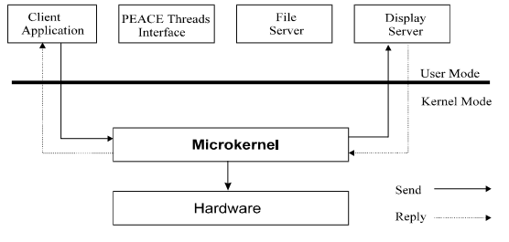
Microkernels
Tanenbaum, Modern Operating Systems 3 e, (c) 2008 Prentice-Hall, Inc. All rights reserved. 0-13-6006639

Slide 25
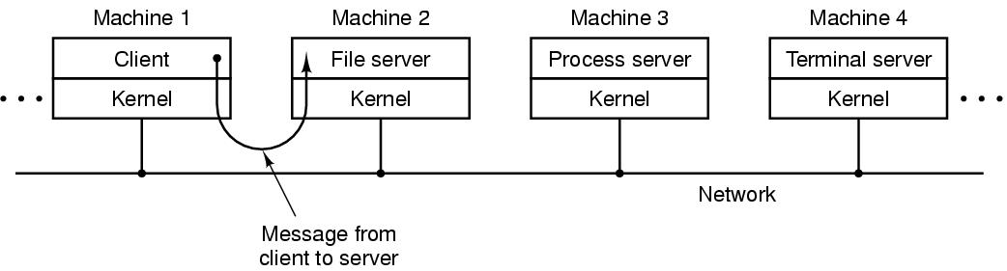
Client-Server Model
The client-server model over a network.
Tanenbaum, Modern Operating Systems 3 e, (c) 2008 Prentice-Hall, Inc. All rights reserved. 0-13-6006639

Slide 26
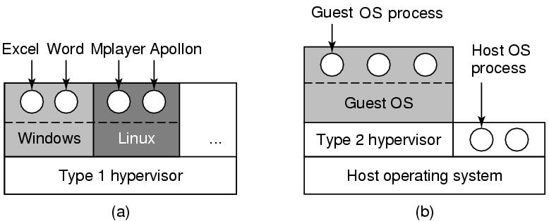
Virtual Machines (2)
(a) A type 1 hypervisor. (b) A type 2 hypervisor.
Tanenbaum, Modern Operating Systems 3 e, (c) 2008 Prentice-Hall, Inc. All rights reserved. 0-13-6006639

Slide 27
Exokernels
Rather than cloning the actual machine
> Giving each user a subset of the resources.
> One virtual machine might get disk blocks 0 to 1023, the
next one might get blocks 1024 to 2047, and so on.
At the bottom layer, running in kernel mode, is a program called the exokernel.
> Its job is to allocate resources to virtual machines and
then check attempts to use them to make sure no machine
is trying to use somebody else’s resources. Each user-
level virtual machine can run its own operating system,
> The advantage of the exokernel scheme is that it saves a
layer of mapping. In the other designs, each virtual
machine thinks it has its own disk.

